Slide 1

Analysis of NFL Lower Body Injuries and the Field/Turf Type They Occurred On
Michael J Fisher 05/16/2022

Slide 2
Business Need: Determine which turf type is least prone to cause injury for new NFL stadium
This project was commissioned by Pat, who is both our key stakeholder for the project as well as a long-time NFL team owner. Pat is in the planning stages of building a new stadium for their team. Given the NFL’s focus on player safety, Pat wanted to ensure the new stadium would use a turf type that was less prone to cause injury.
Due to the tight timeline for the stadium planning, I was given 17 days to find and/or collect adequate data that could be analyzed to provide a result that will inform the key stakeholder if one turf type was less prone to cause injury or not.

Slide 3
The Code: Python, Pandas, Numpy, Scipy, Matplotlib, Seaborn, Qliksense
For this project I was able to source a dataset on Kaggle that was provided directly from the NFL encompassing 2 years of games and 105 total lower-body injuries. The data set was fairly clean and easy to work with. It was provided as separate files for games and injuries. I did have to join the 2 files for analysis.
For the analysis I used a jupyer notebook running a python 3 environment that included the following libraries: Pandas for data manipulation, Numpy for math functions, Scipy for the Chi Square test that was vital to our results, Matplotlib and Seaborn for 1 visualization qliksense was unable to handle and Qliksense for the remaining visualizations.
Jupyter Notebook
Qliksense App

Slide 4
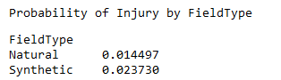
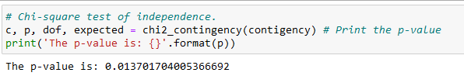
The Results: Implication: Synthetic turf is more prone to cause lower body injury according to this data set
Probability of Injury:
Statistical Significance:

Slide 5
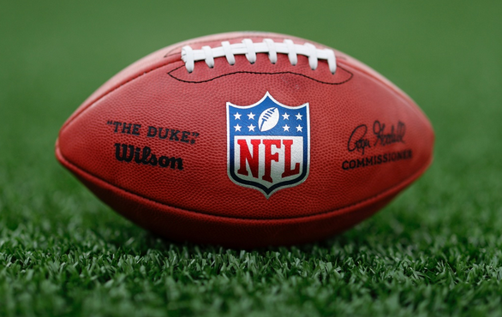
Any Questions?
If there are no other questions, theres only 1 thing left to say…
ARE YOU READY FOR SOME FOOTBALL!!!

